Slide 1
Event Handling

Slide 2

Notes:
A first approach to programming a game often consists of a nightmare spaghetti of includes at the top of cpp files and a frankly absurd dependency graph as every system has to know about every other system to be able to communicate with one another. This also means that a minor change in one subsystem requires us to stick our fingers into most of the others to update API references (or worse, just recompiling a simple change triggers nearly the entire system to be re-built).
Since games are event-driven, we can use an event passing / handling system to deal with a lot of the communication between our systems (and also, our entities). An event can be anything interesting that happens during gameplay; explosions, weapons being picked up, enemies spotting the player – all of these are events. We need a way to a) notify interested objects when an event occurs and b) arrange for these objects to respond to interesting events (to handle the event). An event can also be anything that happens in a system that other systems might want to know about; destroying an actor, firing a sound effect, players connecting to a server etc.

Slide 3

Events and event data
Event handlers
Event Manager
Notes:
So in a well designed game system, our subsystems are entirely responsible for subscribing to and handling game events as they are passed through the system. This makes our event system global to the application – so we can represent it with something like a singleton. So individual subsystems don’t need to know about anything but the event system, they can now just fire an event into the system and any other event that cares about it will listen for it and then “handle” it internally, without ever knowing where it came from.
In effect, we’re building the thing that glues our systems together!
We can break down the system into three parts;

Slide 4

enum EventType
{
Event_Object_Moved,
Event_Object_Destroyed,
Event_Object_Created,
Event_Guard_Alerted,
Event_Guard_Picked_Nose,
...
Event_Something_Happened
};
Notes:
When we’re figuring out how to represent our events, our first thought might be to go for a single giant enumeration that looks something like this, this is OK, but what ends up happening is that every system needs access to the enumeration, as they probably generate one or more of the events – which means we include it in every system, so anytime we touch the list of events, we force a full recompile…
It also means that we’re running the risk of having our system get thrown completely out of whack if anyone references an event by the underlying numeric value, rather than the enum representation. If we do that and another developer adds an entry before the one we’re looking to use, we end up having guards picking their nose rather than being alerted. So this approach is fine for prototypes or small demos, but not full blown games.

Slide 5
GUIDs
0xefbde6eb
6d087ecb8831b4ff6467e4ee30fe5f04
Strings
“event_explosion”
Notes:
Usefully, there are a couple of other approaches we can take that give us some more flexibility: We can generated GUIDs (globally unique identifiers) in VS (or UUID) and use those to uniquely represent our events, but they’re not very readable… You can generate them via the Tools menu in VS, just taking the first set of characters is more than enough for our purposes – we can represent the GUID values as unsigned long variables.
The other approach uses strings, which gives us a whole lot of flexibility – but it suffers from a lot of problems too; we can be impacted by simple typos, potential for event name conflicts, there’s increased memory requirements and string comparisons are expensive beasts. We can alleviate the string comparisons by “hashing” our strings, which changes the comparisons into integers. Even with these downsides, this approach is so flexible that it’s really hard to pass up.

Slide 6

struct Variant
{
enum Type
{
TYPE_INTEGER,
TYPE_FLOAT,
TYPE_BOOL,
TYPE_STRING_ID,
TYPE_COUNT
};
Type type;
union
{
int asInteger;
float asFloat;
bool asBool;
unsigned long asStringId;
};
};
class ExplosionEvent : Event
{
Vector3 center;
float damage;
float radius;
};
Notes:
We’ve got a way of identifying our events, now we need a way of handling the arguments of an event (so the data the event includes as it is passed into the system). So the location of an explosion, its radius and the maximum damage. We can do this by having a base event class that unique events then inherit from and add their own data to:
Gregory also puts forward the idea of a “Variant”, which is capable of holding more than one type of data along with some identifier that says the exact type of data stored in that instance. In this case, we’re using a “union” to let us use the same piece of memory to store several different types of data (though only one at a time). An event may then have a small array or list of variants, depending on how opposed we are to dynamic memory allocations.

Slide 7
Notes:
The last thing to consider when it comes to how our events store data is that at the moment, we’re relying on an indexed collection of event arguments and that means that the event handler has to know the *order* of the arguments in the array. So we can get accidental bugs where an event is updated with an extra argument but a handler is missed and there’s a miss match in what the handler expects to get and what actually comes out of the event.
We can get around this by using Key-Value pairs, with the key being a unique identifier and the value being the variant. So a dictionary or similar data structure could be used to store our collection of arguments and then any event handler just needs to request a value based on a key, rather than knowing the order of presentation.

Slide 8

virtual void Object::OnEvent(Event &event)
{
switch (event.type)
{
case SID('Event_Attack'):
RespondToAttack(event.GetAttackInfo());
break;
case SID('Event_Health_Pack'):
AddHealth(event.GetHealthPack().GetHealth());
break;
// ...
default:
break;
}
}
Notes:
We’ve got events, that can provide us with a good set of extra information – now we need something that can handle them! One of the more common approaches is to have a virtual function that is capable of handling all types of events: (SID in this case is a macro/util function that replaces the string with a suitable hashed representation)
Or we could go down the Unity route and have a series of event specific functions (OnExplode, OnDie, etc) – but that can be problematic as we need to have all these event handlers declared in a base class somewhere, not ideal for events that may only have two things listening for them!
The final approach, that is ideal but is complicated in C++ is to use delegates – which are type safe function pointers in C#, but they don’t exist in quite the same way in C++. We could use a library or an unpleasantly complicated bit of template programming if we really wanted to go that route.

Slide 9

typedef std::map<EventType, std::vector<IEventHandler*>> eventMap;
class EventManager
{
eventMap listeners;
bool AddListener(EventType type, IEventHandler *listener);
void FireEvent(EventType type, IEvent *event);
};
bool EventManager::AddListener(EventType type, IEventHandler *listener)
{
listeners[type].push_back(listener);
}
void EventManager::FireEvent(EventType type, IEvent *event)
{
for (IEventHandler *handler : listeners[type])
{
handler->OnEvent(event);
}
}
Typedef to make life easier
EventManager class should be a singleton
We add a listener by pushing it into a vector that’s stored in the map.
Firing events is as easy as looping the vector and calling OnEvent.
Notes:
Most objects in our game do not need to respond to every event, so while our OnEvent function has a “default” entry, we can go one better and ensure that only those objects that care about an event are told about it.
There are (as ever) several approaches to this, but one of the easiest is to maintain a linked list of interested game objects for each distinct type of event. (A delegate implementation could do this “for free”). This sort of filtering makes our event system much more efficient, we don’t need to loop over all the game objects – just the ones that care about an event!

Slide 10

Control over when events are handled
Ability to post events into the future
Event prioritization
Notes:
Most events will want to be handled immediately – but we can build our system in a way that allows us to queue an event to be handled at some specified future time. It does increase the complexity of our system, but it also has some pleasant benefits:
Certain kinds of events may be highly sensitive to exactly when they are handled in the game loop, if we handle all events immediately upon being sent, we end up with an unpredictable system.
Future: When an event is sent, the sender can specify a delivery time – in frames or seconds. This lets us post events into the future; a blinking light or delayed explosion.
Prioritization: If events are posted and due to run in the same slot, we need some other way of organising them – which we can do by assigning a priority to each event.

Slide 11
Increased event system complexity
Dynamic memory allocation
Debugging difficulties
Notes:
It’s not all roses with delayed event handling, we do get some pros, but there are, of course, some cons:
Our event system becomes substantially more complicated, events become larger and more complex algorithms are required to keep our events in order
Queued events require us to create deep copies of the event data, as we need it to persist for the entire duration of the delay period – this means we need to perform some dynamic memory allocations to store that data, which is, as we know, bad.
It’s now much harder to track down bugs, we no longer have a nice clear call stack to show where a problem came from, we instead have to track down where an event was sent from and what the state of the game was at that point to reproduce issues.

Slide 12

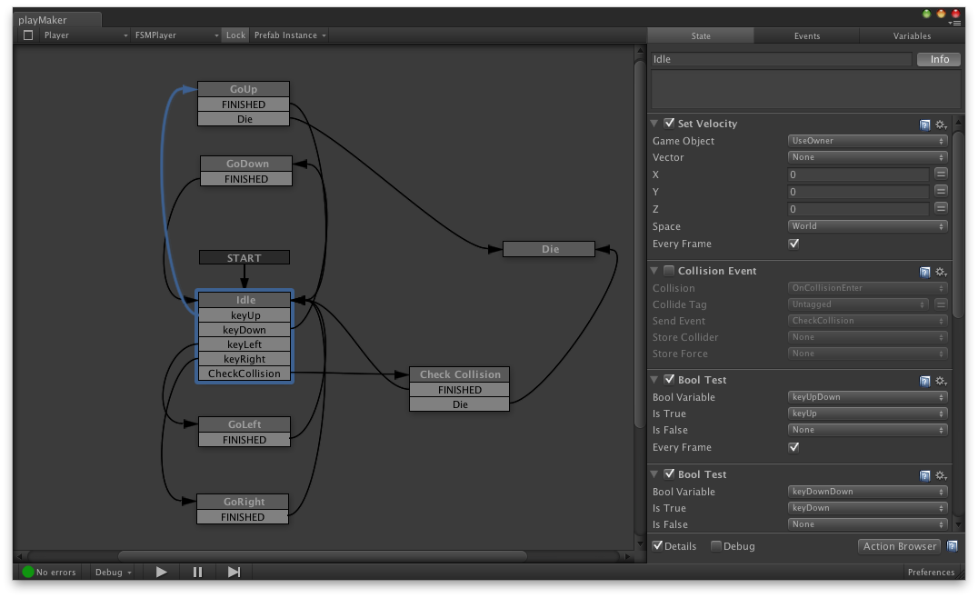
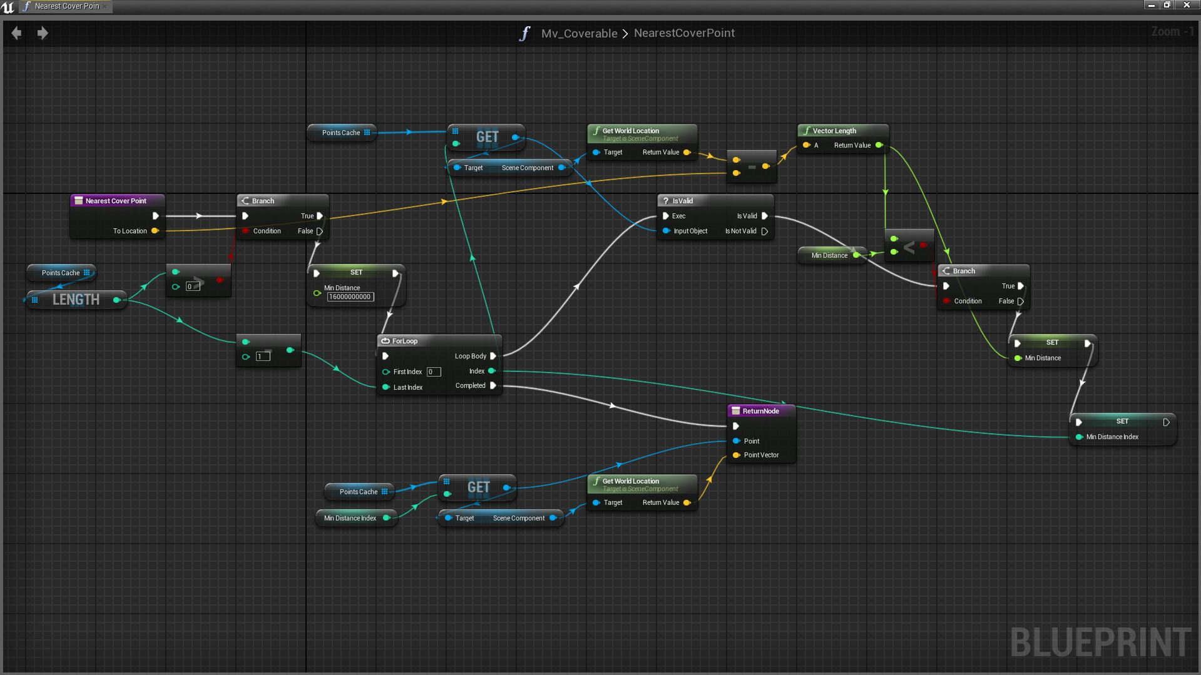
Notes:
So event systems give us a lot of flexibility over and above what can be accomplished with the statically typed function calling we’re used to. But we can do better, so far, all our logic for sending and receiving events is still hard-coded and so reliant on the engineers to modify. If we can take our event system and make it data-driven, we could let game designers make use of its power.
There are plenty of ways of doing this, ranging from fairly simple – where we expose some configuration options to designers by allowing them to configure out individual objects respond to events. In the editor, they might select an object and be able to specify an event it should respond to. At the other end, we open up our entire event system through a scripting language, allowing designers to write complex behaviours and responses to events without an engineer getting involved. So designers can define new types of events, send events and receive and handle events in arbitrary ways.

